Slide 1
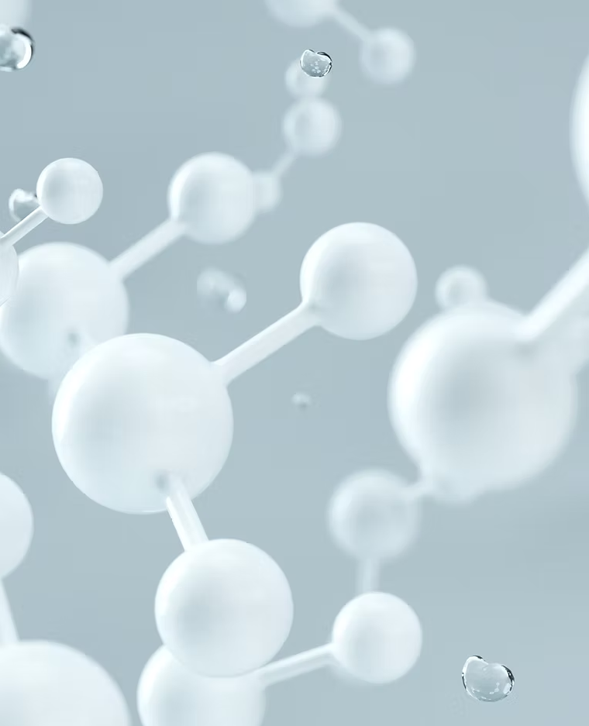
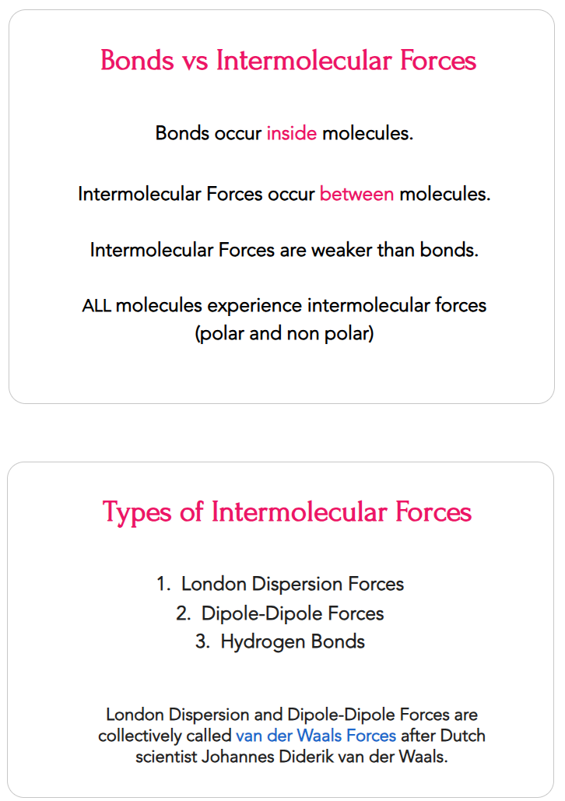

Slide 2
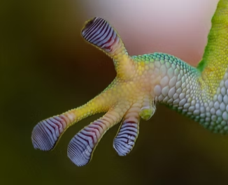
Cu
Cu
Cu
Cu
Cu
Cu
Cu
Cu
Cu
Cu
Cu
Cu
Cu
Cu
Cu
Cu
Cu
Cu
Cu
Cu
Cu
Cu
Cu
Cu
Cu
Cu
Zn
Cu
Cu
Cu
Cu
Cu
Cu
Zn
Cu
Cu
Cu
Cu
Cu
Cu
Cu
Cu
Zn
Cu
Cu
Cu
Cu
Cu

Slide 3
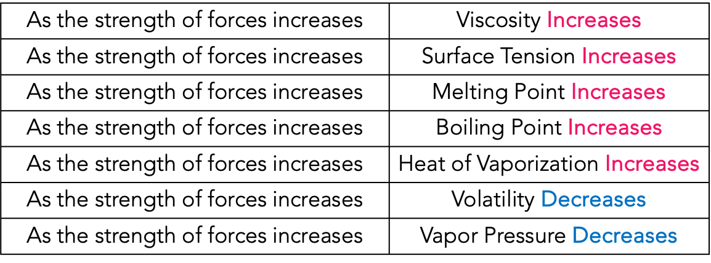
As the strength of forces increases | Viscosity Increases
As the strength of forces increases | Surface Tension Increases
As the strength of forces increases | Melting Point Increases
As the strength of forces increases | Boiling Point Increases
As the strength of forces increases | Heat of Vaporization Increases
As the strength of forces increases | Volatility Decreases
As the strength of forces increases | Vapor Pressure Decreases

Slide 4
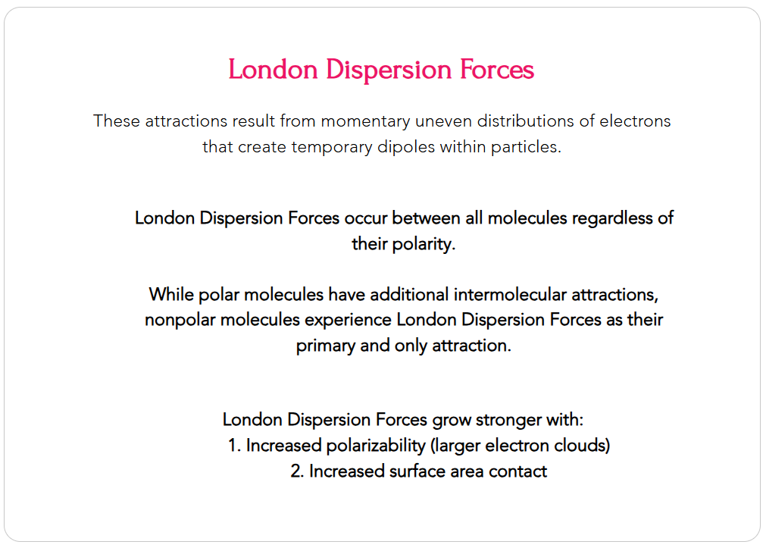
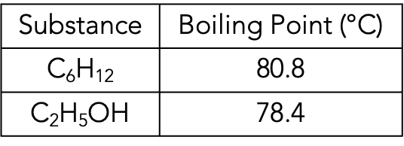
Substance | Boiling Point (°C)
C₆H₁₂ | 80.8
C₂H₅OH | 78.4

Slide 5
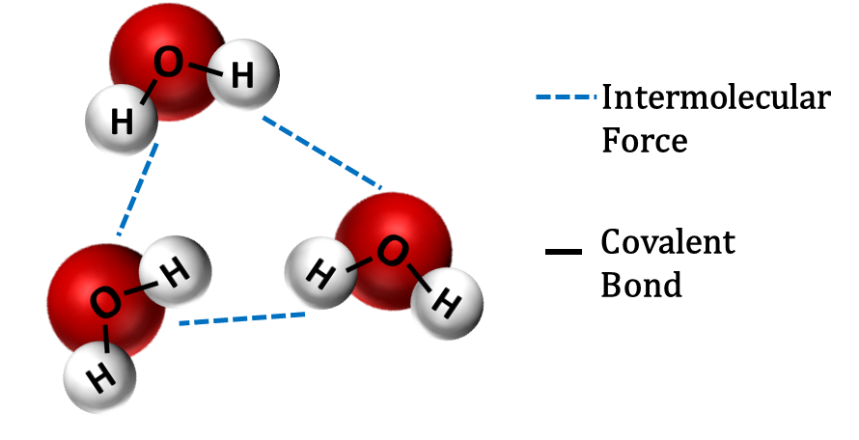
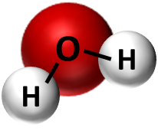


Intermolecular
Force
Covalent
Bond
+
Adjacent polar molecules
Adjacent polar and non-polar molecules
Adjacent non-polar molecules
_

Slide 6
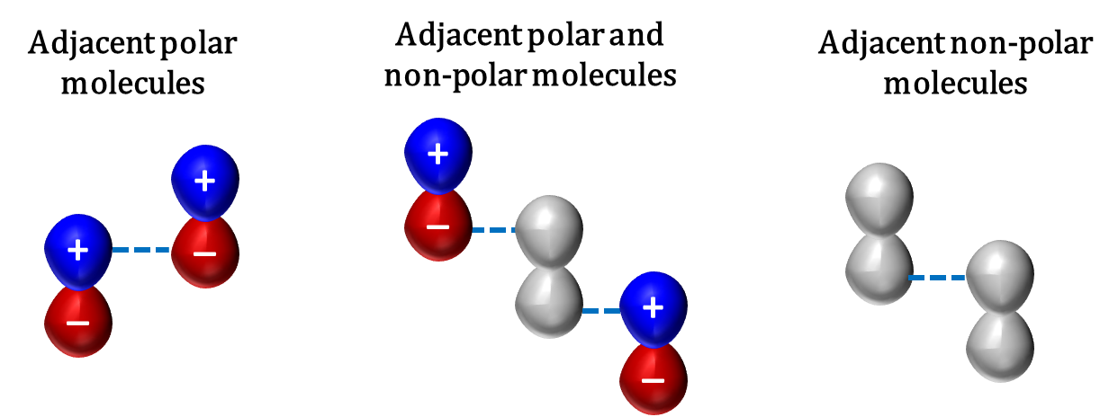

Slide 7
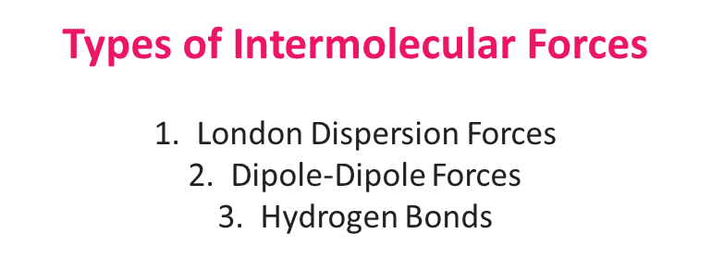
Types of Intermolecular Forces
​1. London Dispersion Forces
2. Dipole-Dipole Forces​
3. Hydrogen Bonds

Slide 8
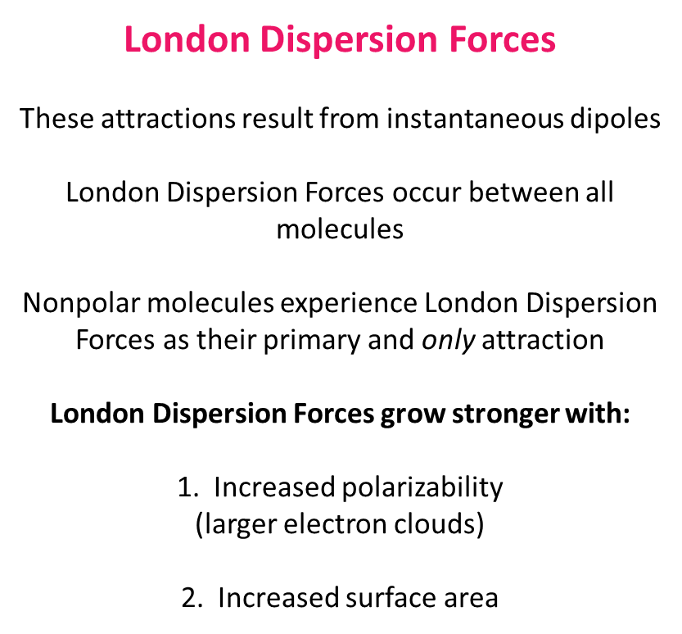
London Dispersion Forces
These attractions result from instantaneous dipoles
London Dispersion Forces occur between all molecules
Nonpolar molecules experience London Dispersion Forces as their primary and only attraction
London Dispersion Forces grow stronger with:
Increased polarizability (larger electron clouds)
Increased surface area

Slide 9
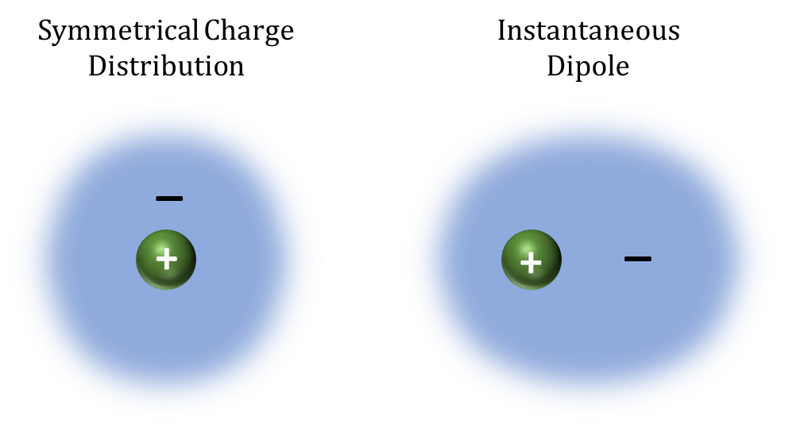
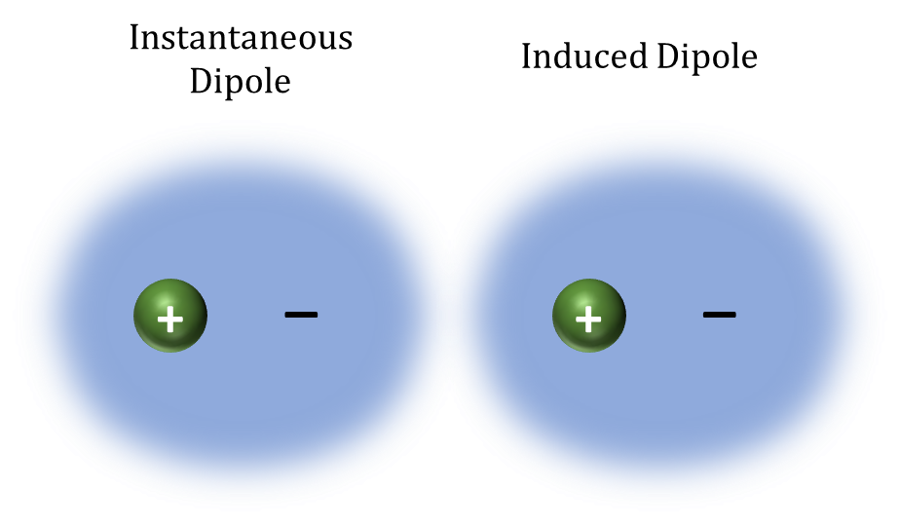
Symmetrical Charge Distribution
Instantaneous Dipole
Instantaneous Dipole
Induced Dipole
_
_
_
_
+
+
+
+

Slide 10

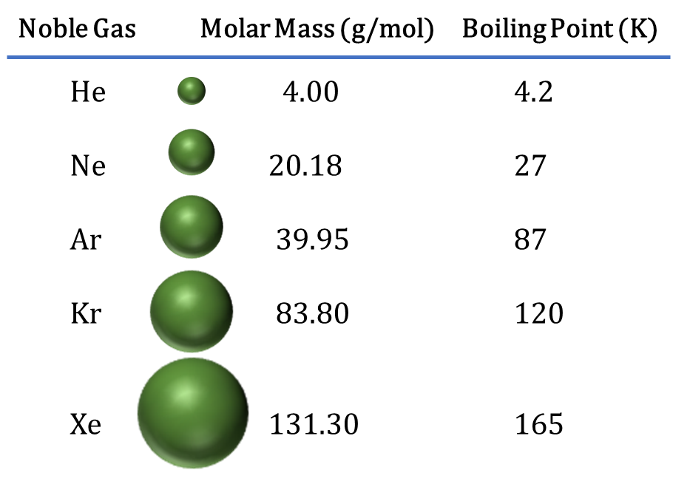
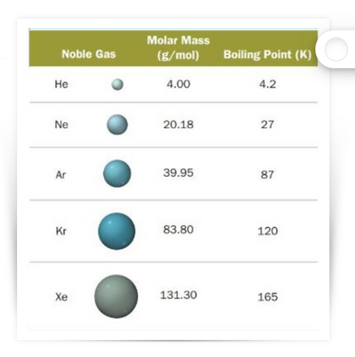
Noble Gas Molar Mass (g/mol) Boiling Point (K)
He 4.00 4.2
Ne 20.18 27
Ar 39.95 87
Kr 83.80 120
Xe 131.30 165

Slide 11
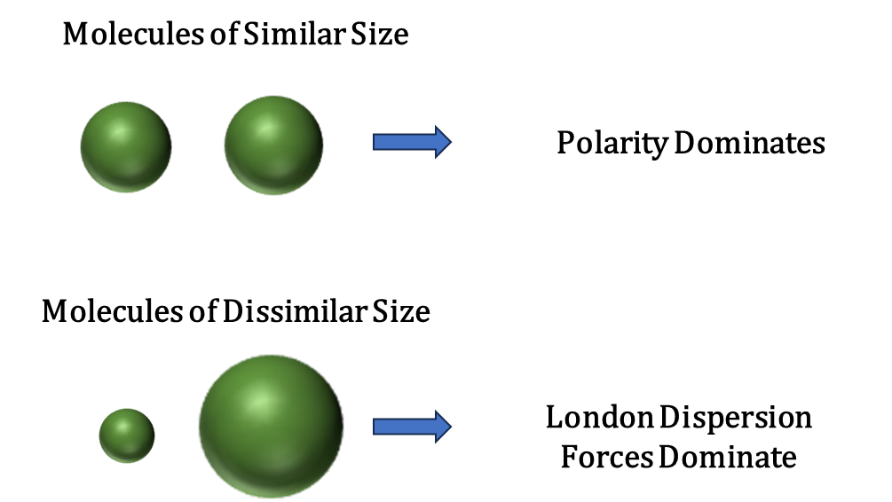
Molecules of Similar Size
Polarity Dominates
Molecules of Dissimilar Size
London Dispersion
Forces Dominate

Slide 12
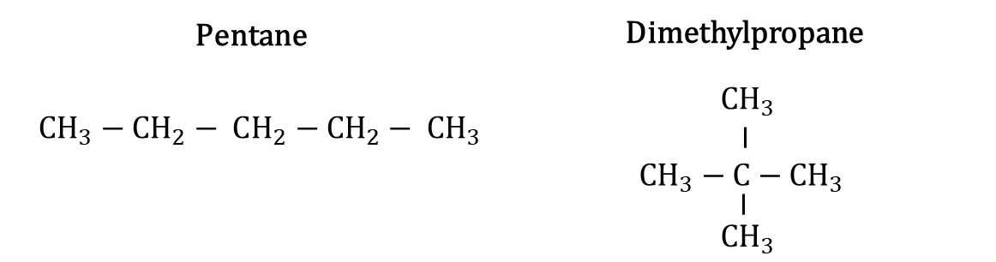




Pentane
Dimethylpropane
$$CH_{3}$$
$CH_{3}−$ $CH_{2}− CH_{2}$ $−$ $CH_{2}− CH_{3}$
$CH_{3}−$ $C−CH_{3}$
$$CH_{3}$$

Slide 13
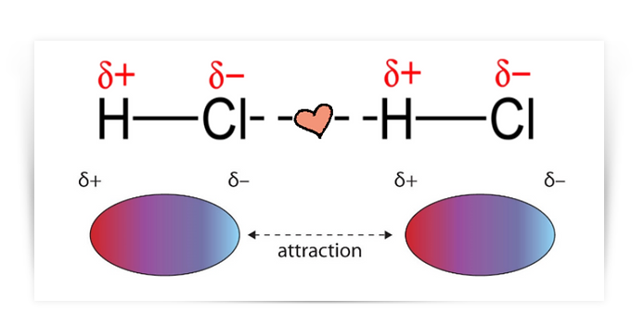
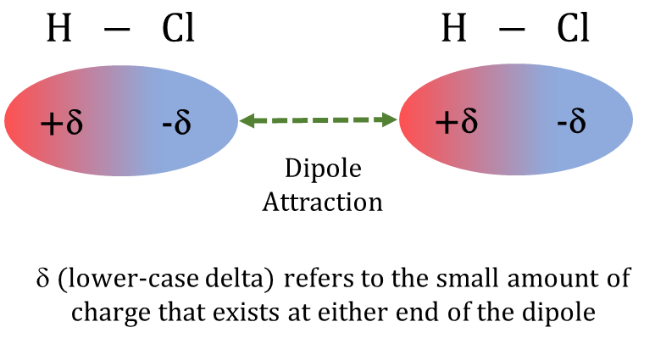


$H −$ $Cl$
$H −$ $Cl$
+δ
-δ
+δ
-δ
Dipole Attraction
δ (lower-case delta) refers to the small amount of charge that exists at either end of the dipole

Slide 14
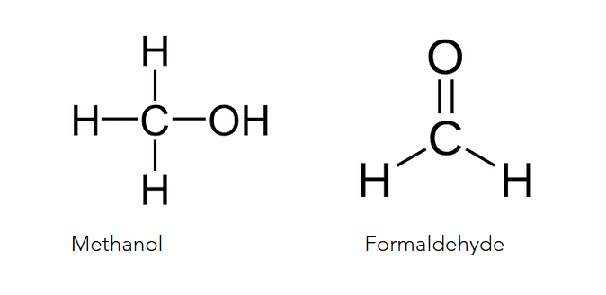
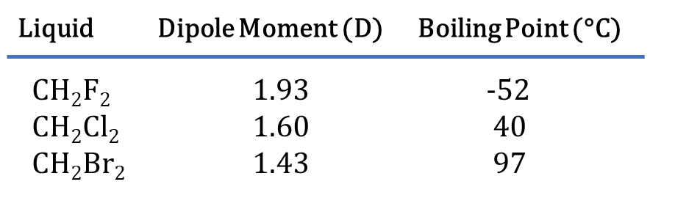
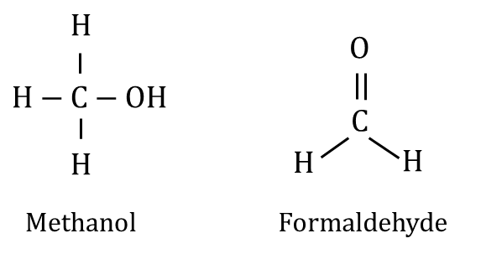







Liquid Dipole Moment (D) Boiling Point (°C)
CH₂F₂ 1.93 -52
CH₂Cl₂ 1.60 40
CH₂Br₂ 1.43 97
$$H$$
$$O$$
$H−$ $C−OH$
$$C$$
$$H$$
$$H$$
$$H$$
Methanol
Formaldehyde

Slide 15
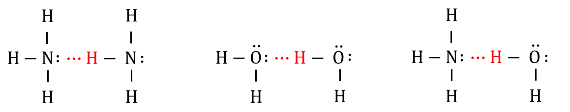












$$H$$
$$H$$
$$H$$
$$∶$$
$$∶$$
$$∶$$
$$∶$$
$H−$ $N ∙∙∙H− O$
$H−$ $N ∙∙∙H− N$
$H−$ $O ∙∙∙H− O$
$$∶$$
$$∶$$
$$∶$$
$$∶$$
$$∶$$
$$H$$
$$H$$
$$H$$
$$H$$
$$H$$
$$H$$

Slide 16
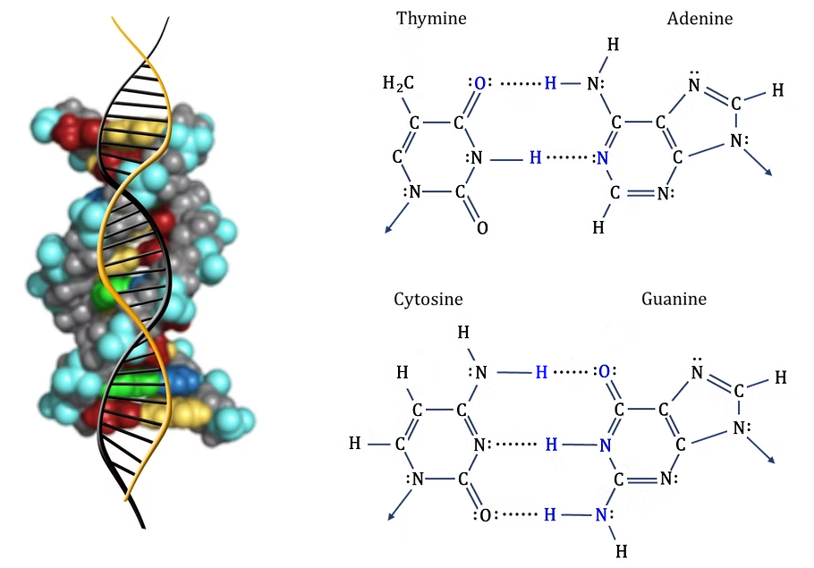

Slide 17
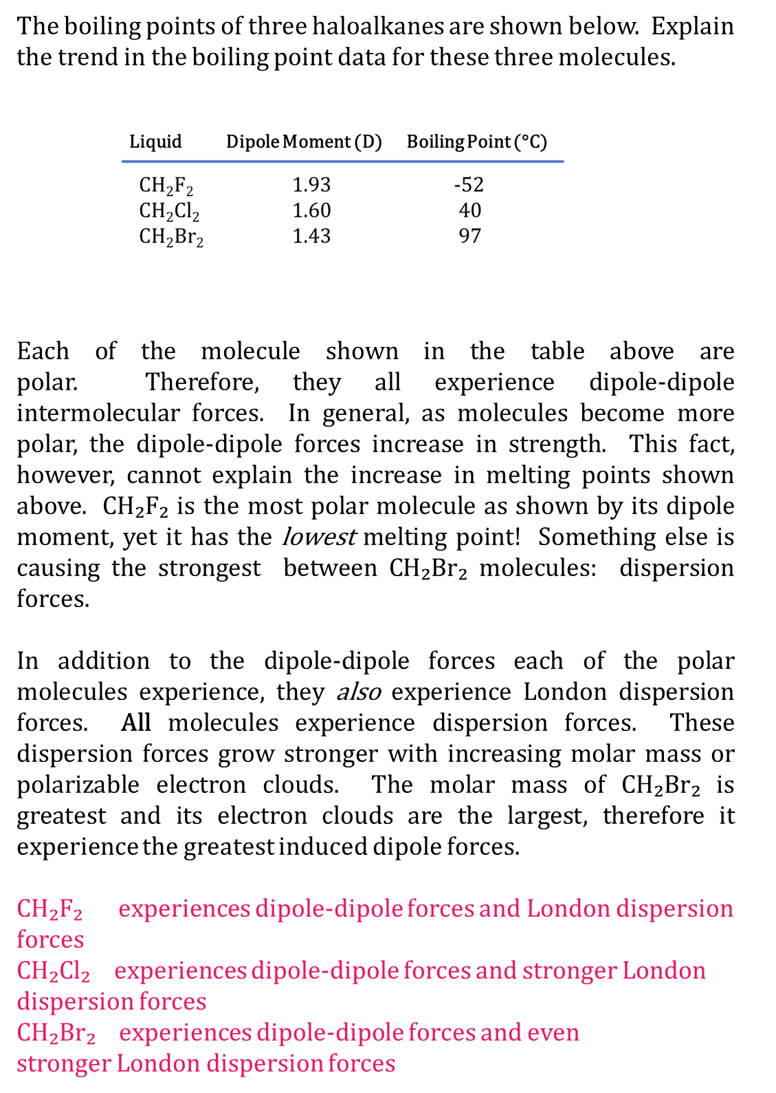
The boiling points of three haloalkanes are shown below. Explain the trend in the boiling point data for these three molecules.
Each of the molecule shown in the table above are polar. Therefore, they all experience dipole-dipole intermolecular forces. In general, as molecules become more polar, the dipole-dipole forces increase in strength. This fact, however, cannot explain the increase in melting points shown above. CH₂F₂ is the most polar molecule as shown by its dipole moment, yet it has the lowest melting point! Something else is causing the strongest between CH₂Br₂ molecules: dispersion forces.
​
In addition to the dipole-dipole forces each of the polar molecules experience, they also experience London dispersion forces. All molecules experience dispersion forces. These dispersion forces grow stronger with increasing molar mass or polarizable electron clouds. The molar mass of CH₂Br₂ is greatest and its electron clouds are the largest, therefore it experience the greatest induced dipole forces.
​
CH₂F₂ experiences dipole-dipole forces and London dispersion forces
CH₂Cl₂ experiences dipole-dipole forces and stronger London dispersion forces
CH₂Br₂ experiences dipole-dipole forces and even stronger London dispersion forces

Slide 18
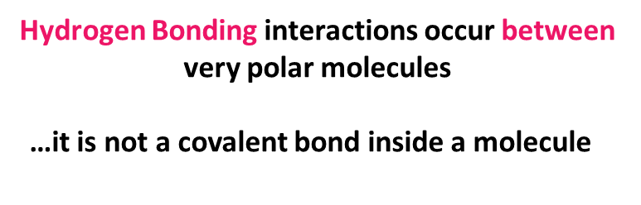
​​​Hydrogen Bonding interactions occur between very polar molecules
…it is not a covalent bond inside a molecule

Slide 19
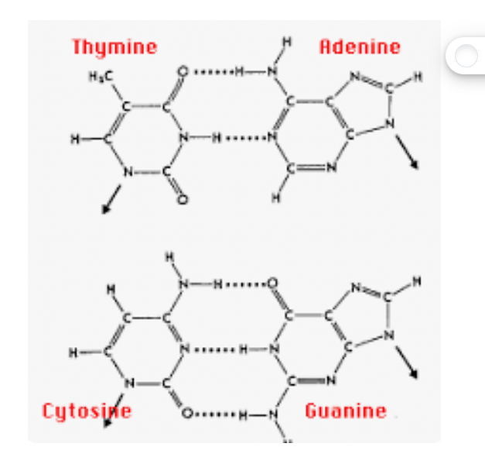







Thymine
Adenine
H
H₂C
$$∙∙∙∙∙∙∙$$
$$∶$$
O
H
N
$$∶$$
$$∶$$
$$∶$$
N
H
C
C
C
C
C
$$∶$$
N
$$∶$$
C
$$∙∙∙∙∙∙∙$$
C
N
H
N
$$∶$$
$$∶$$
N
C
C
N
$$∶$$
$$∶$$
$$∶$$
O
H
Cytosine
Guanine
$$∶$$
H
$$∶$$
$$∶$$
H
$$∙∙∙∙∙∙$$
O
N
H
$$∶$$
$$∶$$
N
$$∶$$
H
C
C
C
C
C
N
$$∙∙∙∙∙∙∙$$
$$∶$$
H
C
N
H
N
C
$$∶$$
N
C
C
N
$$∶$$
$$∶$$
$$∙∙∙∙∙∙∙$$
O
H
N
$$∶$$
$$∶$$
$$∶$$
H

Slide 20
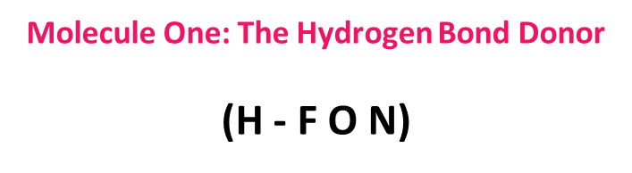
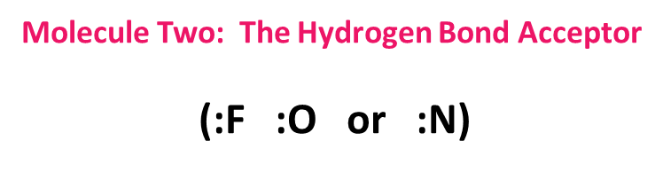
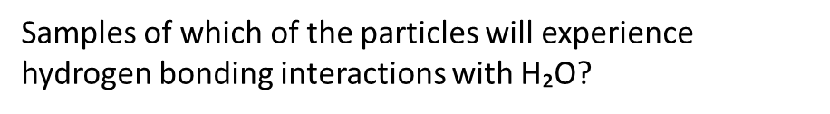
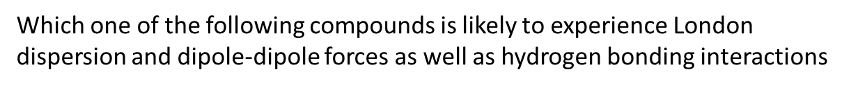
Molecule One: The Hydrogen Bond Donor
(H - F O N)
Molecule Two: The Hydrogen Bond Acceptor
(:F :O or :N)
Samples of which of the particles will experience hydrogen bonding interactions with H₂O?
Which one of the following compounds is likely to experience London dispersion and dipole-dipole forces as well as hydrogen bonding interactions

Slide 21
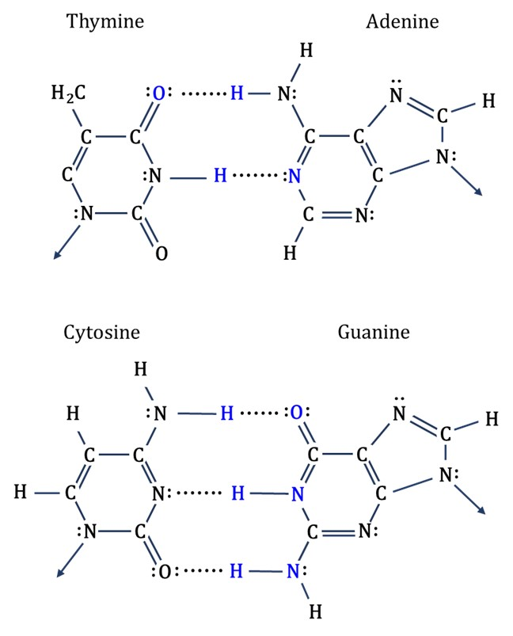
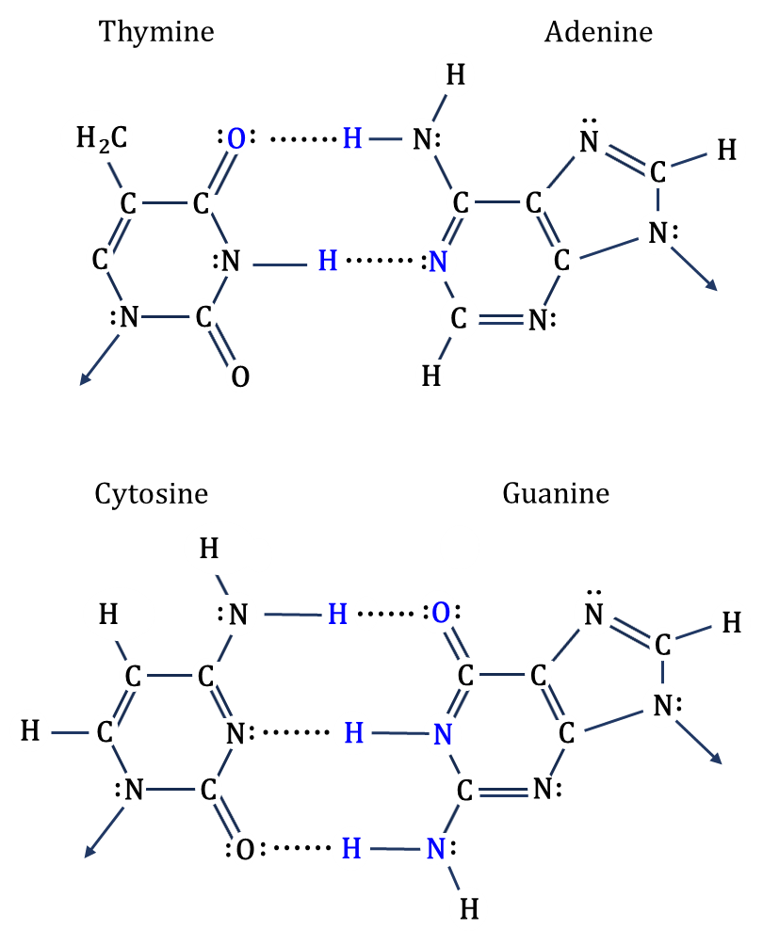

Slide 22
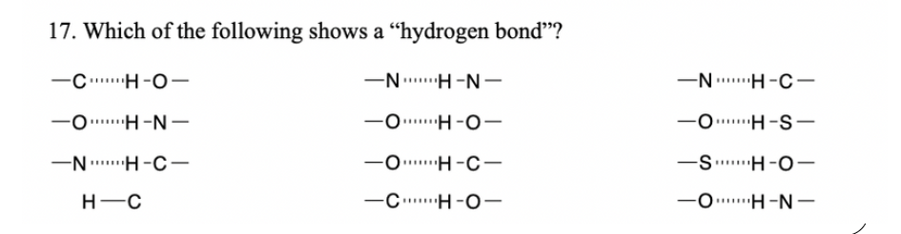
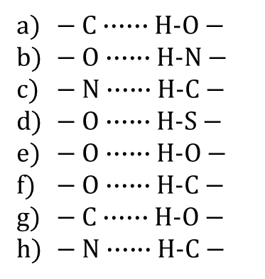
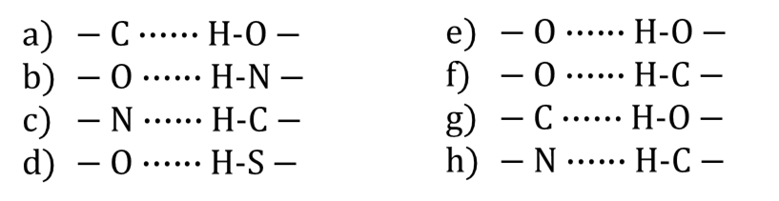
-
- SDGVS
$−$ $C∙∙∙∙∙∙H\text{−}O−$
$−$ $O∙∙∙∙∙∙H\text{−}N−$
$−$ $N∙∙∙∙∙∙H\text{−}C−$
$−$ $O∙∙∙∙∙∙H\text{−}S−$
$−$ $O∙∙∙∙∙∙H\text{−}O−$
$−$ $O∙∙∙∙∙∙H\text{−}C−$
$−$ $C∙∙∙∙∙∙H\text{−}O−$
$−$ $N∙∙∙∙∙∙H\text{−}C−$

Slide 23
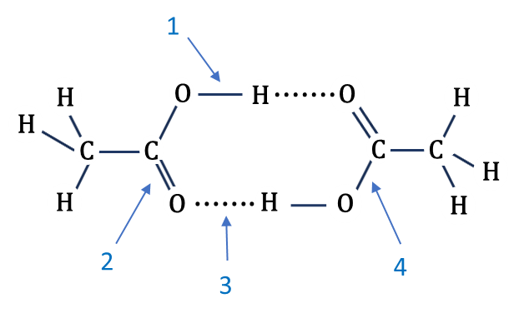
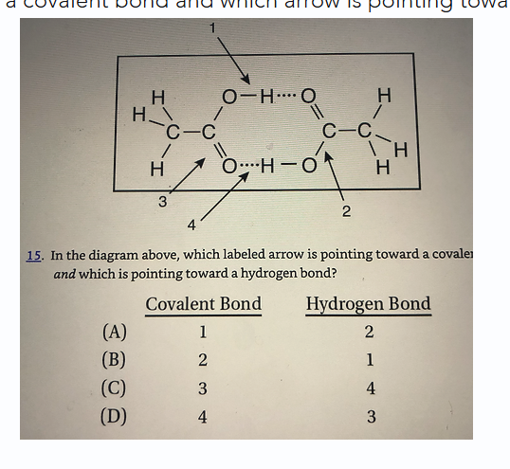


1
O
$$∙∙∙∙∙∙∙$$
H
H
O
H
H
C
C
C
C
H
$$∙∙∙∙∙∙∙$$
H
O
H
O
H
2
4
3

